Slide 1
A survey on
Brain tumor
Classification

Slide 2
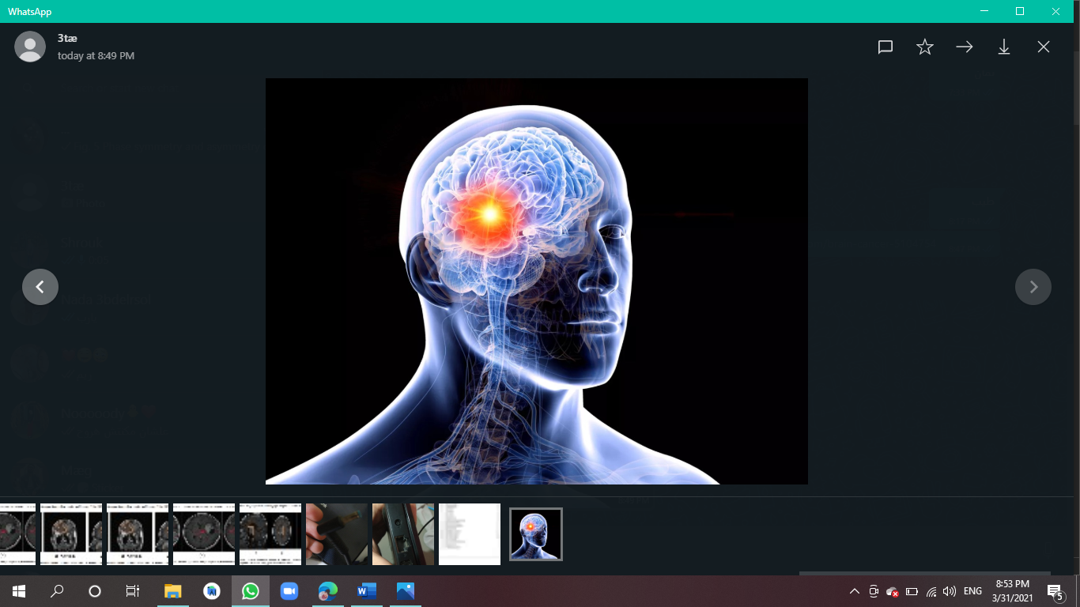
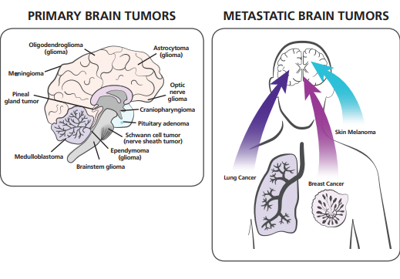
Chapter 1
Brain tumor
A brain tumor is an abnormal growth of tissue in the brain or central spine that can disrupt proper brain function Doctors refer to a tumor based on where the tumor cells began, and whether they are cancerous (malignant) or not (benign)
Metastatic brain tumors
begin as cancer elsewhere in the body and spread to the brain
Primary brain tumors
A tumor that first develops in the brain.It may spread to other parts of the nervous system, but rarely spreads to other parts of the body

Slide 3
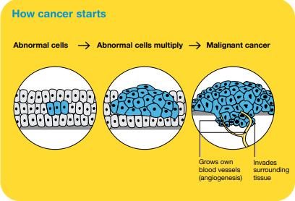
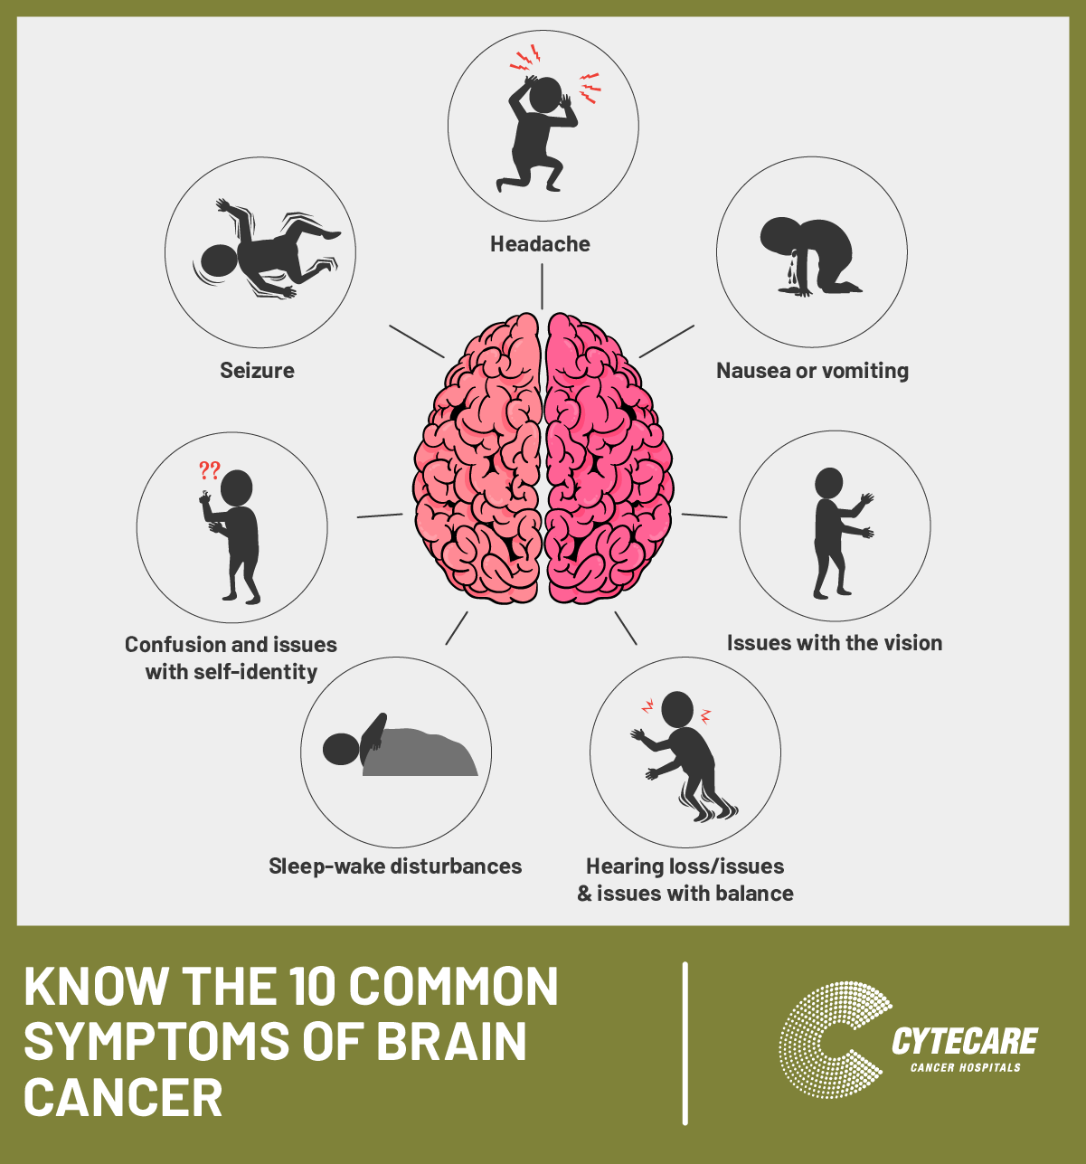
Infographic Style
Brain Tumor Causes
You can simply impress your audience and add a Brain tumors are thought to arise when certain genes on the chromosomes of a cell are damaged and no longer function properly. These genes normally regulate the rate at which the cell divides zing and appeal to your Presentations.
Symptoms
Symptoms vary depending on the location of the brain tumor:
Headaches that may be more severe in the morning or awaken the patient at night
Seizures or convulsions
Difficulty thinking, speaking or articulating
Personality changes
Weakness or paralysis in one part or one side of the body
Loss of balance or dizziness
Vision changes
Hearing changes
Facial numbness or tingling
Nausea or vomiting, swallowing difficulties
Confusion and disorientation

Slide 4
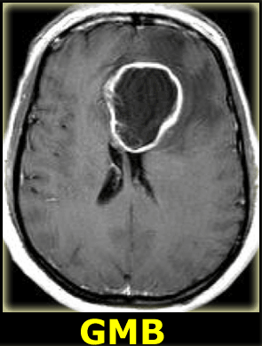
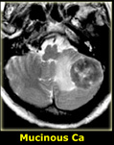
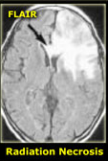
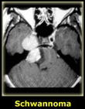
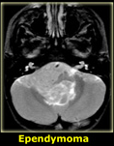
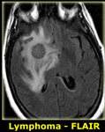
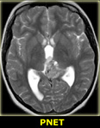
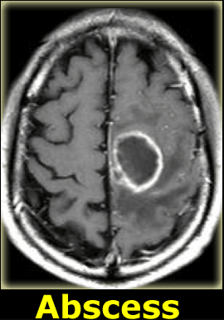
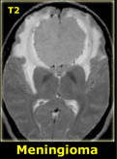
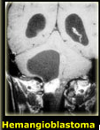
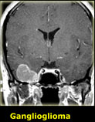
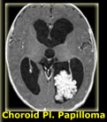
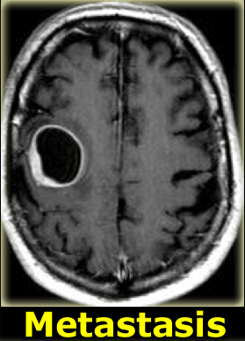
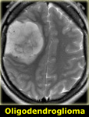
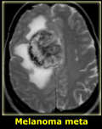
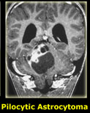
Side effects of a brain tumor
Emotional side effects
Emotional side effects are natural for any major disease, brain tumor or not. When a brain tumor is diagnosed, it can take away your sense of security and control. Uncertainty is among the most challenging things that you may have to grapple with on a day-to-day basis. Depression
Cognitive side effects
Cognitive side effects are those that affect your ability to process information and communicate.
Physical effects
Physical effects are common as treating a brain tumor can take a great toll on your body. le.
Types of brain tumors

Slide 5
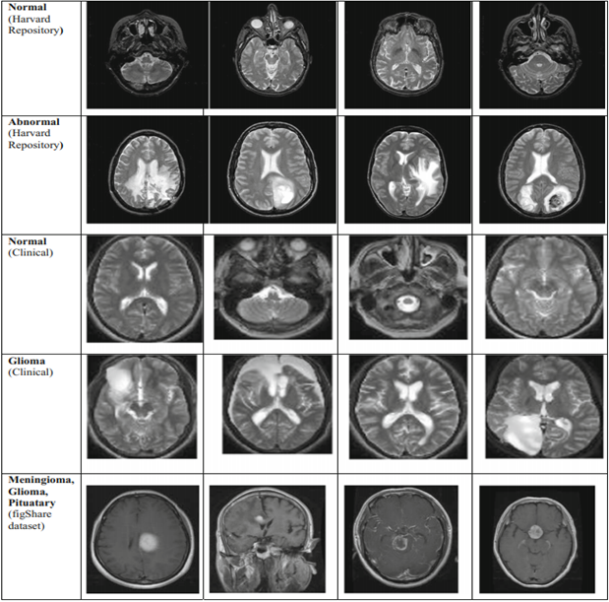
Types of secondary brain tumors
Lung cancer
Breast cancer
Melanoma
Colon cancer
Kidney cancer
Radiology Imaging Techniques of Brain Tumors
Types of databases (Datasets)
Conventional imaging methods
Conventional non-invasive X-ray methods
Computed Tomography – CT
Magnetic Resonance Imaging – MRI
Digital subtraction angiography – DSA

Slide 6
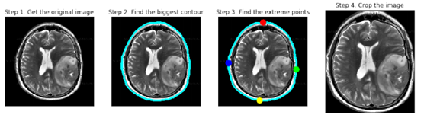
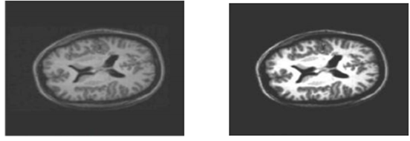
Chapter 2. Pre-processing Techniques
A brief of Data preprocessing
Image Pre-Processing is the first step of image processing.
It is used to enhance the chances of identifying the relevant region
Data Splitting
Crop Normalization
3. Resizing of images

Slide 7
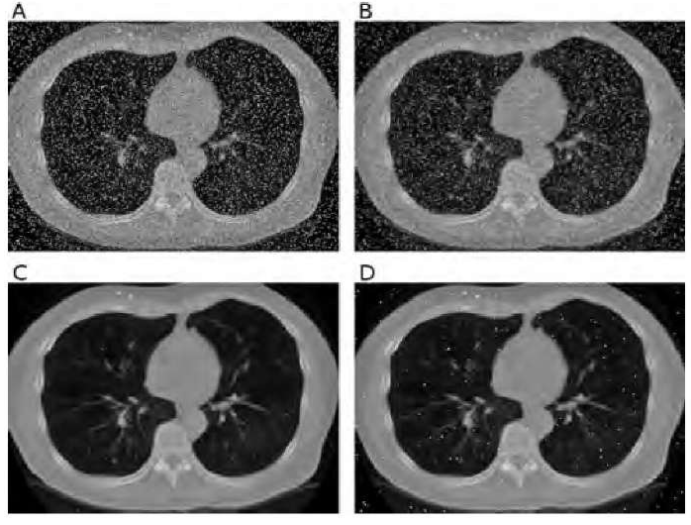
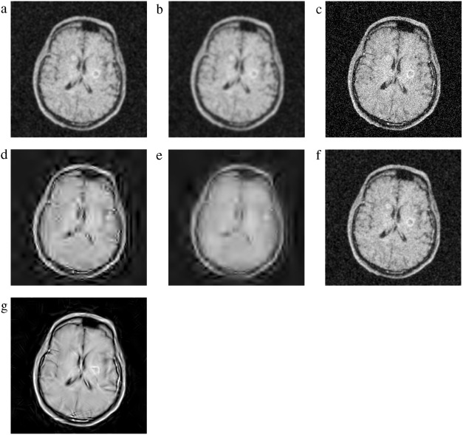
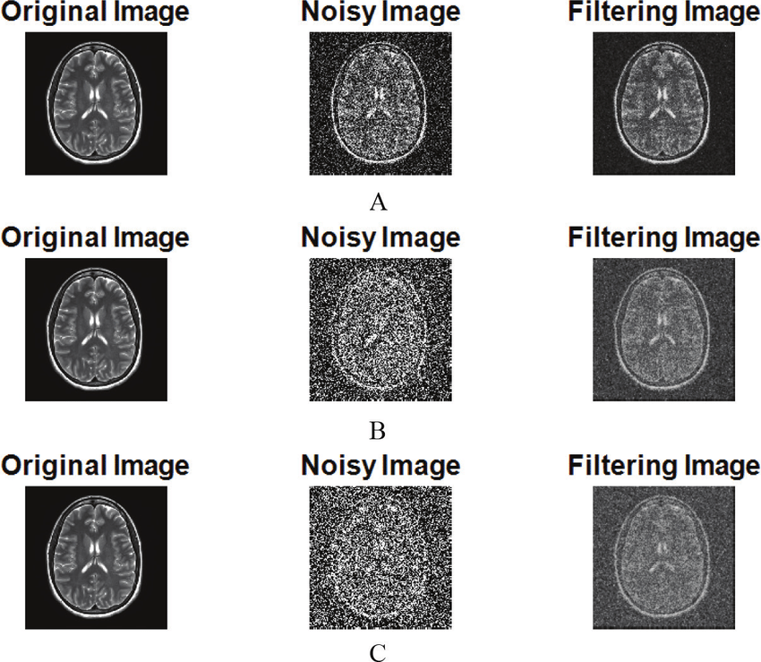
4. Median Filter
6. Hybrid Filter
7. Modified Hybrid
8. Morphology Based De-noising
5. Wiener Filter

Slide 8
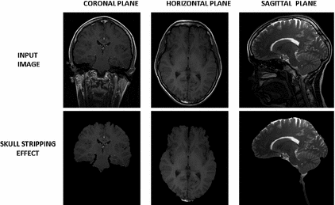
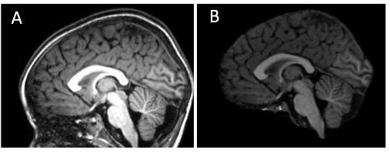
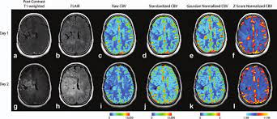
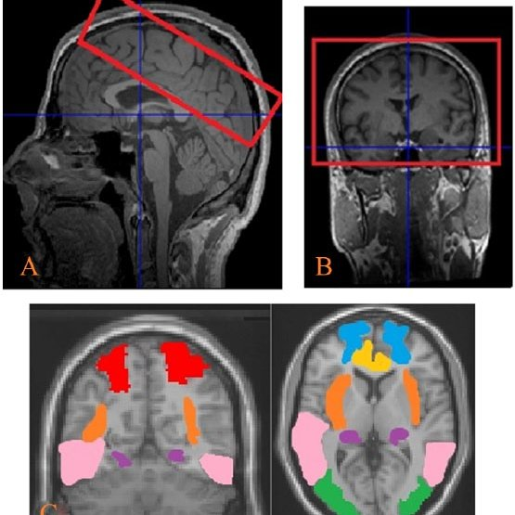
9.Morphological Opening
12. Intensity Zero-centering
13. Intensity Normalization
10 .Power law Transformation
11. ROI segmentation

Slide 9
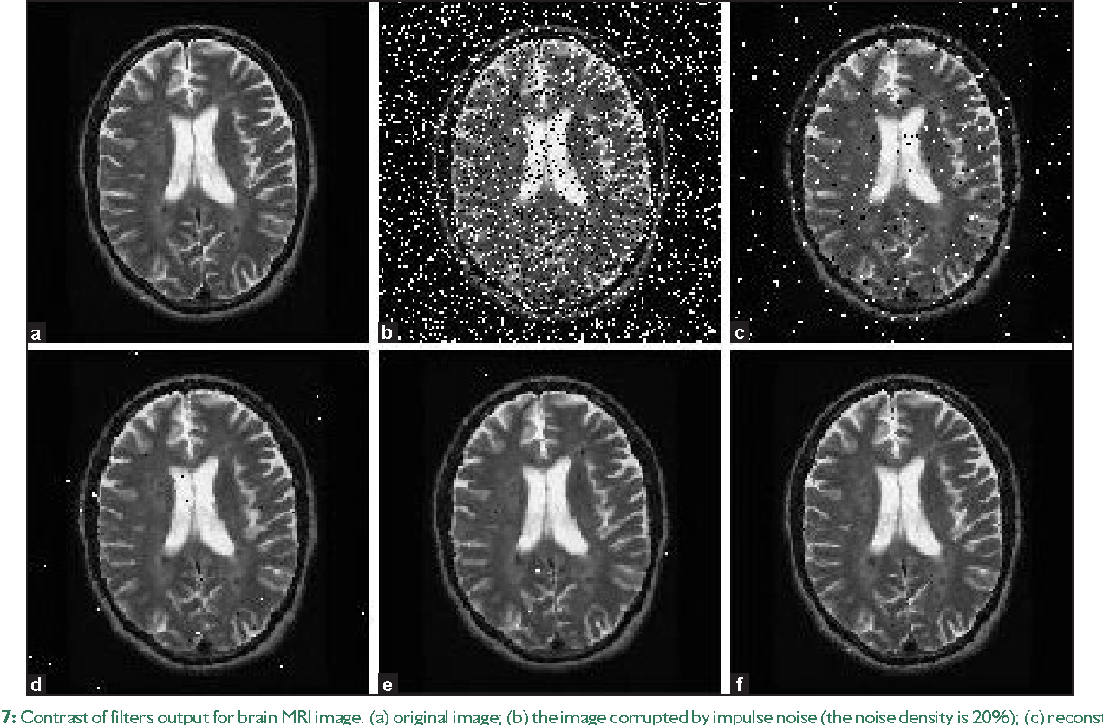
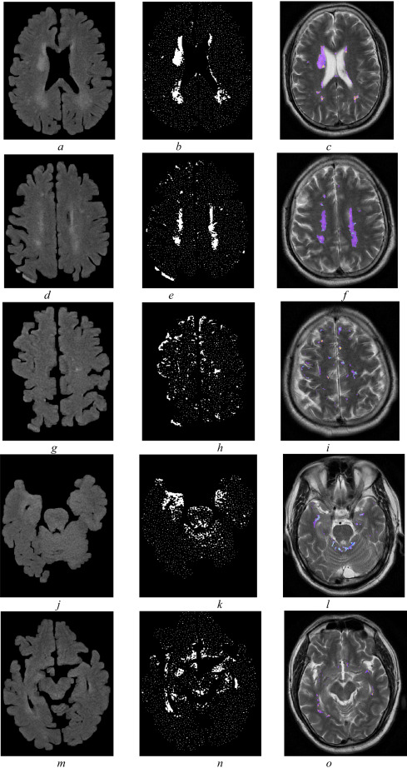
14. Image Re-sampling
15, Gray Scale Contrast Enhancement
16. Noise Removal

Slide 10
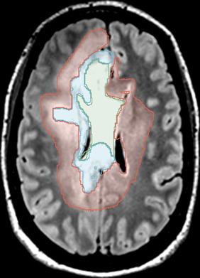
17. Mathematical Operation
1. Dilation
2. Erosion
3. Opening
4. Closing

Slide 11
FEATURE EXTRACTION
it is an extract group of features to classify pictorial data
Multiple algorithms have been developed to extract high-value complex features
GLCM
MSE
RICGF
Edge detection

Slide 12
1. GLCM
also known as
the gray-level spatial dependence matrix
Is a statistical method that characterize the texture of an image by
calculating how often pairs of pixel with specific values and in a specified spatial relationship occur in
an image, creating a GLCM, and then extracting statistical measures from this matrix
Contrast (C)
Correlation (S)
Cluster prominence
Energy (E)
Homogeneity (H)
Autocorrelation
( ASM )
Coarseness
( SSIM )

Slide 13
Contrast (C)
Contrast of the image gives a measure of sudden change in intensity values in image
Autocorrelation
the autocorrelation feature of an image is used to estimate the fineness or roughness of the texture existing in the image.
Correlation (S)
It is a measure of correlation of a pixel to its neighbor within the selected region in the image
Cluster prominence
is a measure of asymmetry. If the image is less symmetric, then the value of cluster prominence is high

Slide 14
Energy (E)
It is the measure of the extent of pixel pair repetitions. It measures the
homogeneity or uniformity of an image. When pixels are identical, the energy value will be huge
Homogeneity (H)
it is the measure which grows with lower contrast
Angular Second Moment (ASM)
It is known as the summation of the squares of gray levels of the image
Coarseness (𝐶𝑛𝑒𝑠𝑠)
is a measure of roughness in the textural analysis of an image. For a fixed window size
Structured Similarity Index (SSIM)
is a metric that signifies that the degradation in image quality may be caused by data compression or losses in data transmission or by any other means of the image processing

Slide 15
2. Mean Square Error (MSE)
It is a measure of signal fidelity or image fidelity. The purpose of signal or image
( PSNR )
Dice Coefficient
Dissimilarity
( IBF )
Mean ( m )
Variance
( Std )
Skewness
Kurtosis
( IDM )
Entropy

Slide 16
Peak Signal-to-Noise Ratio (PSNR)
It is a measure used to assess the quality of reconstruction of processed image
Dice Coefficient
It is a measure of overlap between the two images
Dissimilarity
It is a measure of distance between pairs of objects (pixels) in the region of interest
Intensity-Based Features (IBF)
First-order histogram gives distinct statistical properties such as four statistical moments of the intensity histogram of an image
Mean (m)
It is defined as the sum of the intensity values of pixels divided by the number of pixels in the SROI of an image

Slide 17
Variance
This parameter calculates the heterogeneity which strongly correlated with the standard deviations.
Standard Deviation (Std)
it is a measure of homogeneity characteristics of an image
Skewness
It is the measure of symmetry and asymmetry of the gray level values around the mean.
Kurtosis
It is a measure of whether the data are peaked or flat relative to the normal distribution.
Inverse Difference Moment (IDM)
IDM measures the local homogeneity of an image
Entropy
It represents the amount of randomness in gray level intensity distribution of an image

Slide 18
3. Rotation Invariant Circular Gabor Features (RICGF)
is a Gaussian kernel function modulated by a radially sinusoidal surface wave

Slide 19
4. Edge detection
The edge representation of an image significantly reduces the quantity of data to be processed, yet it retains essential information regarding the shapes of objects.
Second order derivative or Zero crossing
First order edge detection or gradient based edge operator

Slide 20
First order edge detection or gradient based edge operator
the first order derivative operators are very sensitive to noise and produce thicker edges
Robert operator
Sobel operator
Prewitt operator
Kirsch Edge detection
Robinson Edge detection

Slide 21
Robert operator
It performs a simple, quick to compute, 2-D spatial gradient measurement on an image. This method emphasizes regions of high spatial frequency which often correspond to edges.
Sobel operator
The image is processed in the X and Y directions separately first, and then combined together to form a new image
Prewitt operator
Prewitt operator is similar to the Sobel operator and is used for detecting vertical and horizontal edges in images. It is one of the best ways To estimate the magnitude and orientation of an edge

Slide 22
Kirsch Edge detection
The masks of this Kirsch technique are defined by considering a single mask and rotating it to eight main compass directions: North, Northwest, West, Southwest, South, Southeast, East and Northeast
Robinson Edge detection
It is similar to Kirsch masks but is easier to implement because they rely only on coefficients of 0, 1 and 2.

Slide 23
Second order derivative or Zero crossing
In this operator a pixel is marked as an edge at a position where second derivative of an image becomes zero.
Marr-Hildreth operator
Laplacian of Gaussian (LoG) operator

Slide 24
Marr-Hildreth operator
It is a method of detecting edges in digital images
Algorithm for the Marr Hildreth edge detector is Smooth the image using a Gaussian Apply a two-dimensional Laplacian to the smoothed image
Laplacian of Gaussian (LoG) operator
It is defined as It has two effects, it smoothed the image and it computes the
Laplacian, which yields a double edge image. Locating edges then consists of finding the zero crossings

Slide 25
5. Optimal Edge Detection
Canny Operator
it is a method to find edges by isolating noise from the image without affecting the features of the edges in the image and then applying the tendency to find the edges and the critical value for threshold.
6. Local binary pattern
It is a simple, quick, and very efficient method for extracting feature from image texture
7. Histogram Orientation Gradient (HOG)
It is a method in computer vision and image processing that is used to detect the object. In this method, the image is divided into small areas that are joined together, they are called cells

Slide 26
8. Monogenic Signal Analysis
The monogenic signal is an image analysis approach based on analytic signal concept and this isotropic generalization has been used for various image analysis and computer vision applications
9. Combined Local Binary Patterns (CLBP)
is a combination of local binary patterns (CLBP) descriptor that generalizes LBP effectively for the texture analysis.

Slide 27
10. Shape Feature
Shape features are extracted using region props. Shape features are center of gravity, Circularity ratio, Rectangularity
1. Centre of gravity
The center of gravity is also called centroid. Its position should be fixed in relation to the shape
2. Circularity ratio
Circularity ratio stands for how a shape is like a circle. Circularity ratio is the ratio of the area of a shape to the shape‟s perimeter square
3. Rectangularity
Rectangularity stands for how rectangular a shape is, i.e. how much it fills its smallest bounding rectangle

Slide 28
11. Feature Reduction
More number of features increases the computational time and memory storage and hence makes the classification of images more complicated
1. Principal Component Analysis (PCA)
It is used as statistical tools for providing orthogonal transformation of data to a new coordinate system and summarizing the variances that eliminate the least contributing
2. Independent component analysis (ICA)
is one of the higher-order methods. The projections of ICA are linear but not surely orthogonal. These are statistically independent to each other, which is a stronger condition than uncorrelated ness.

Slide 29
12. Discrete Wavelet Transform (DWT)
is an operation of wavelet transform using a discrete set of the wavelet scales and
translation following some specific price- dent The proposed system extracts the wavelet coefficient from brain MRI images using the DWT coefficient.
13. Log-Polar Transformation (LPT)
is an effective and validate mechanism for the conversion of image geometry from the Cartesian domain to log-polar domain retaining the rotation and scaling invariant properties.
14. Mining Association rules
growth Association rule mining typically aims at discovering associations between items in a transactional database
15. Morphological Features
The morphology of the tissue has a significant role in defining that the tissue is regular or irregular.

Slide 30
16. Texture Feature
Texture is one of the important properties used to recognize the region of interest in the image
17. Scale Invariant Feature Transform (SIFT) Features
has been broadly and effectively applied to object detection and face recognition/verification It has also been used to analyses the problems of panoramas reconstruction
18. Elliptic Fourier Descriptors (EFDs)
The EFDs features are suitable for distinguishing the images having epileptic shape. EFDs features are introduced by Nicolet al. [48] to classify the sold objects such as tank, windmill
19. Entropy Features
The biological signals are the output of multiple interacting components of biological systems that exhibit patterns in a complex rhythm.

Slide 31
20. Quantitative Image Feature Extraction
the central goal of radionics is the development of image analytic
techniques that can reproducibly extract objective, quantitative data from MR imaging scans.
21. Computational Image Descriptors
Radionics relies on computational techniques in computer vision to extract many quantitative features from radiologic images
22. Biologically Inspired Feature Descriptor
build on specific biologic hypotheses that transfer the recognized radiology knowledge into quantitative representation, as opposed to pure computational approaches for feature extraction
23. Moment Invariant Feature Extraction
recognition methods based on image moments.

Slide 32
24. Binary Association Rule Generation
The conceit of feature selection involves in reducing the inputs to an endurable size for effective processing and analysis.
25. DT-CWT
The multidimensional (M-D) dual-tree CWT is no detachable but is based on a ciphering adequate, separable filter bank (FB)
26. PNN
Probabilistic (PNN) and General Regression Neural Networks (GRNN) have collateral architectonics, but there is a integral inequality
27. How PNN network work: Probabilistic
Neural networks are rudimentary coincidental to K-Nearest Neighbor (kNN) models

Slide 33
28. SFCM
Neighboring pixels possess highly correlated intensities, and Probability of their
belongingness to the same cluster high .therefore spatial relationship is important of clustering.

Slide 34
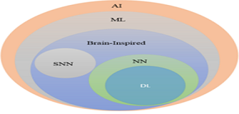
Deep Learning and Convolutional Neural Network
Fig. 4.1. AI: Artificial Intelligence ML, NN, DL, and Spinking Neural Networks (SNN)
Types of DL approaches
Supervised Learning
Semi-supervised Learning
Unsupervised learning
Deep Reinforcement Learning (DRL)

Slide 35
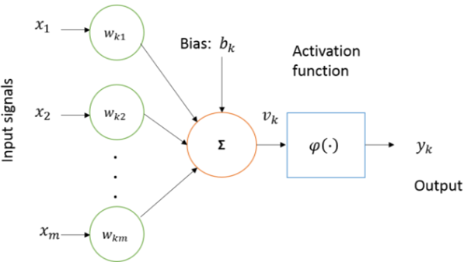
Feature Learning
Fig.4.2. Basic model of neuron

Slide 36
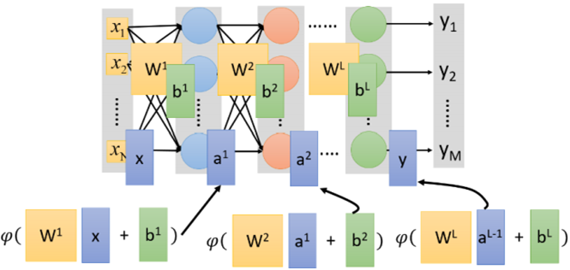
ANN
Fig.4.3. Neural network model with multiple layers perceptron

Slide 37
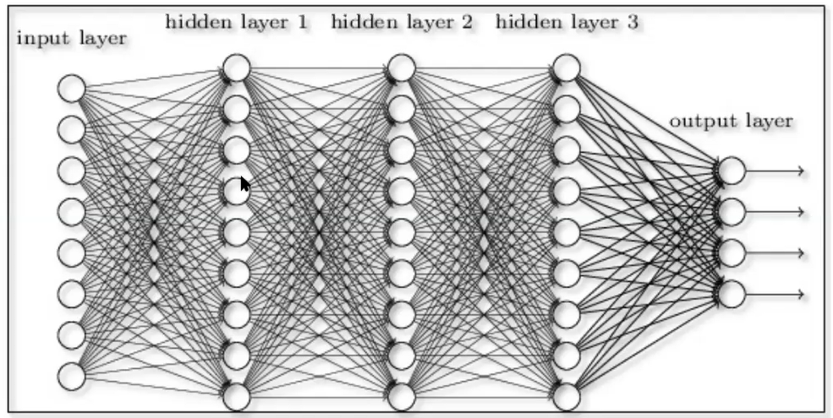

Slide 38
Optimization algorithms
Stochastic Gradient Descent (SGD)
Back-propagation
Momentum
Learning rate (𝜼)
Weight decay

Slide 39
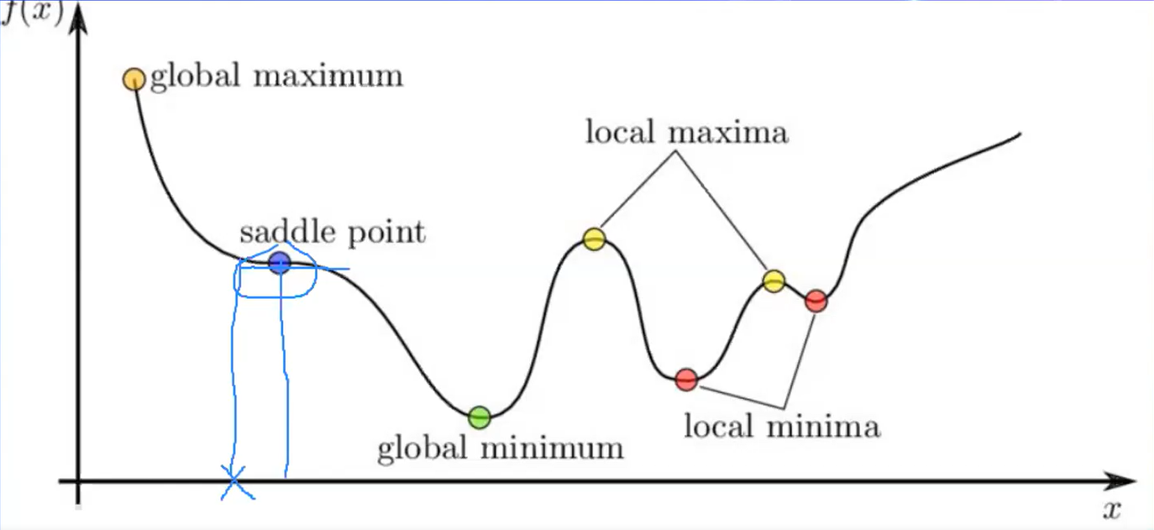

Slide 40
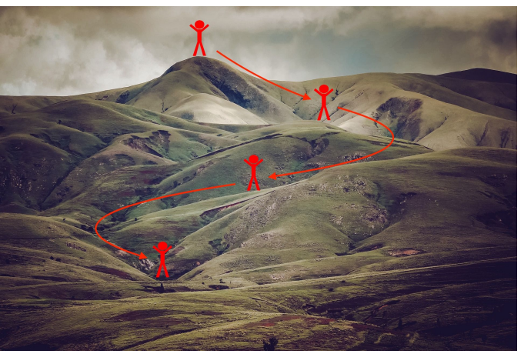
Error Mountain

Slide 41
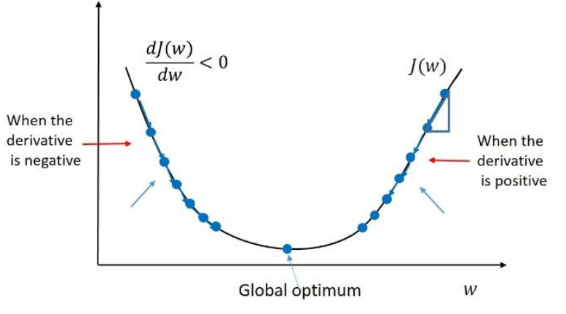

Slide 42
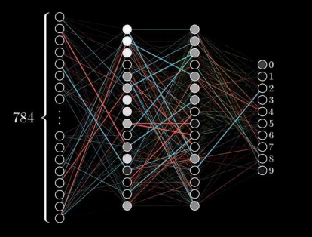
Back-propagation

Slide 43
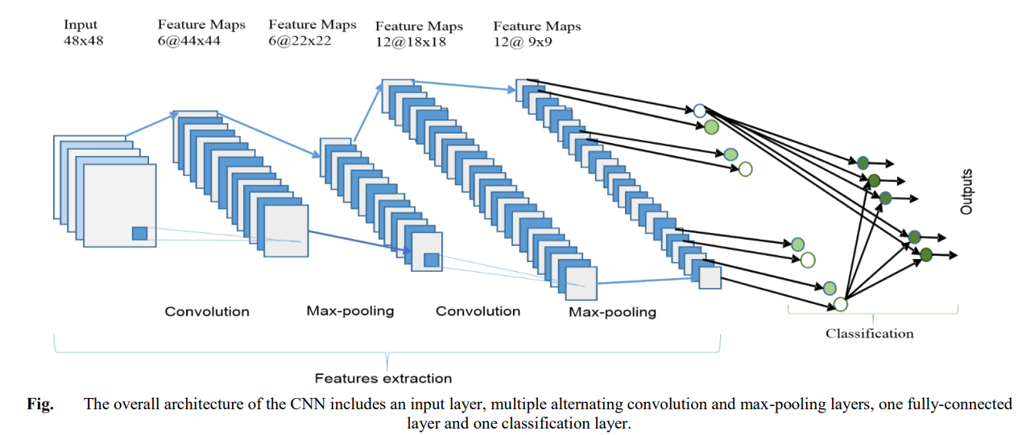
CNN
1.Convolution Layer
2.Sub-sampling Layer
3.Classification Layer
Fig.4.4. The overall architecture of the CNN include an input layer. Multiple altemating convolution and max-pooling, one fully connected layer and one classification layer

Slide 44
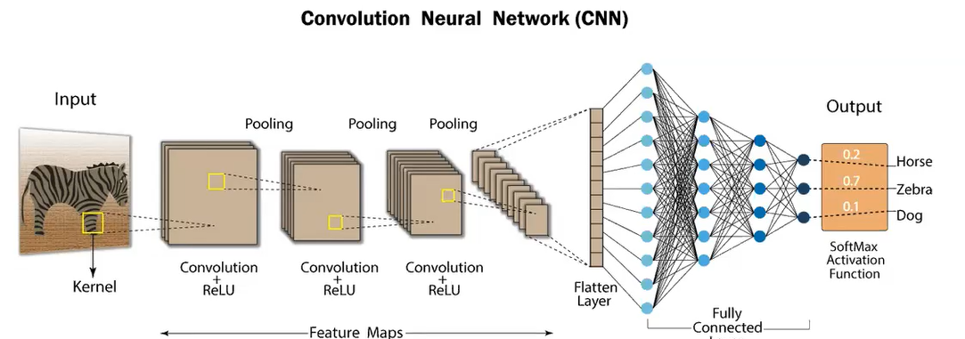

Slide 45
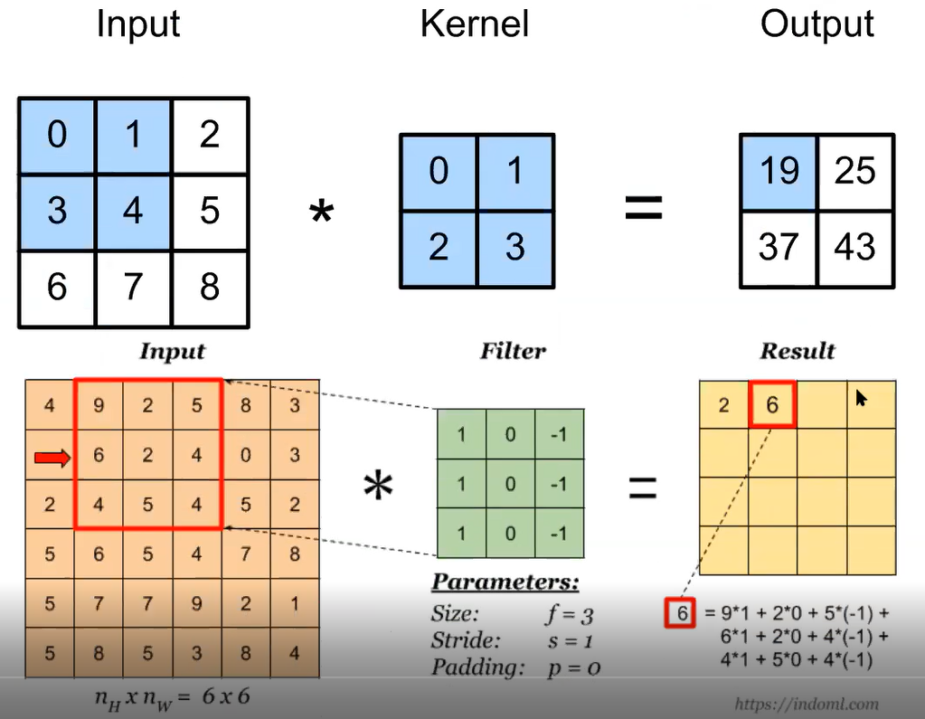
1.Convolution Layer

Slide 46
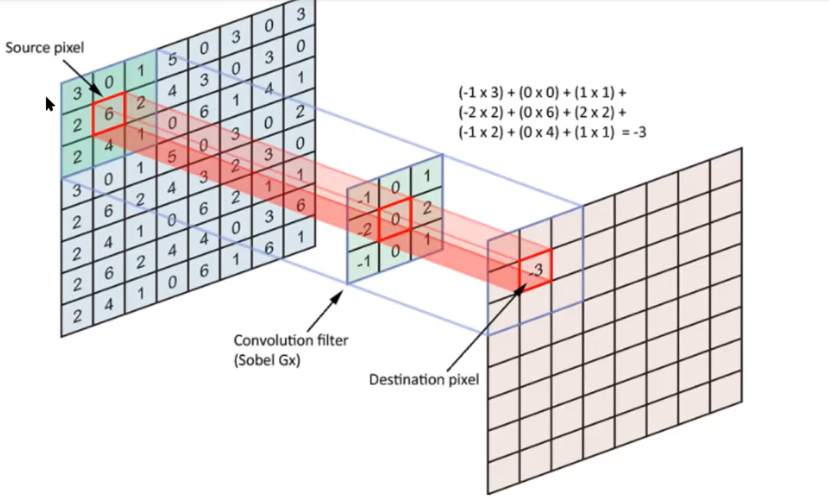

Slide 47
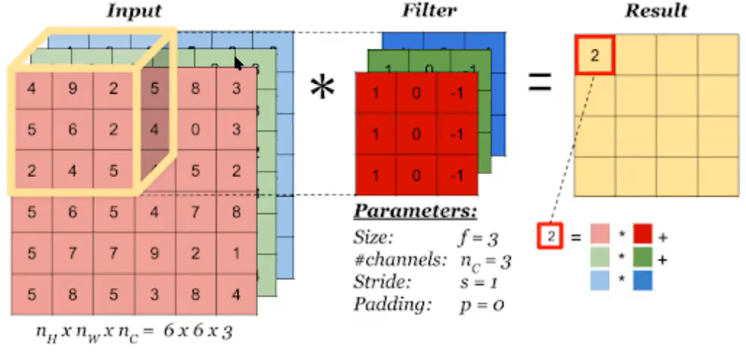

Slide 48
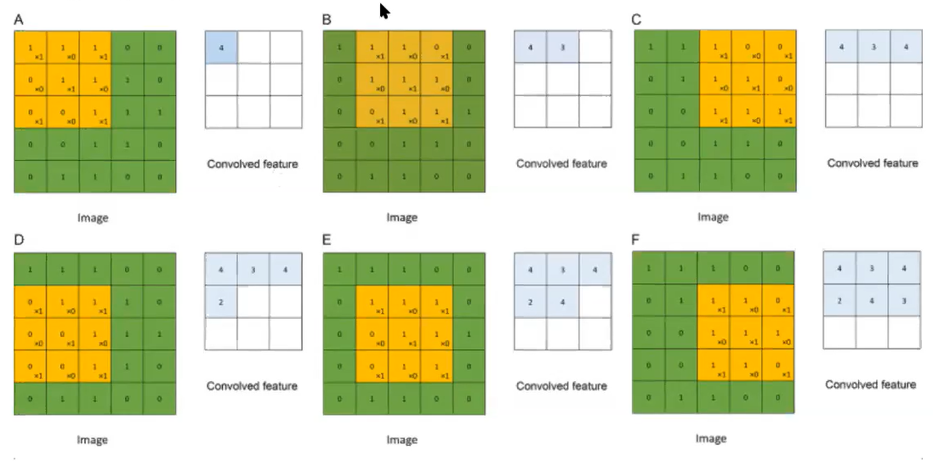

Slide 49
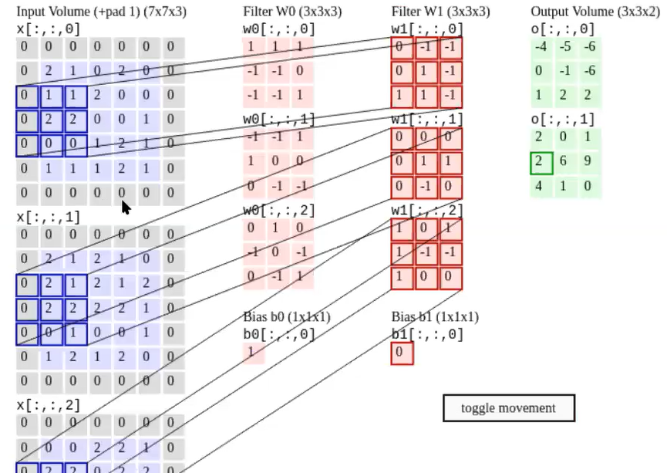

Slide 50
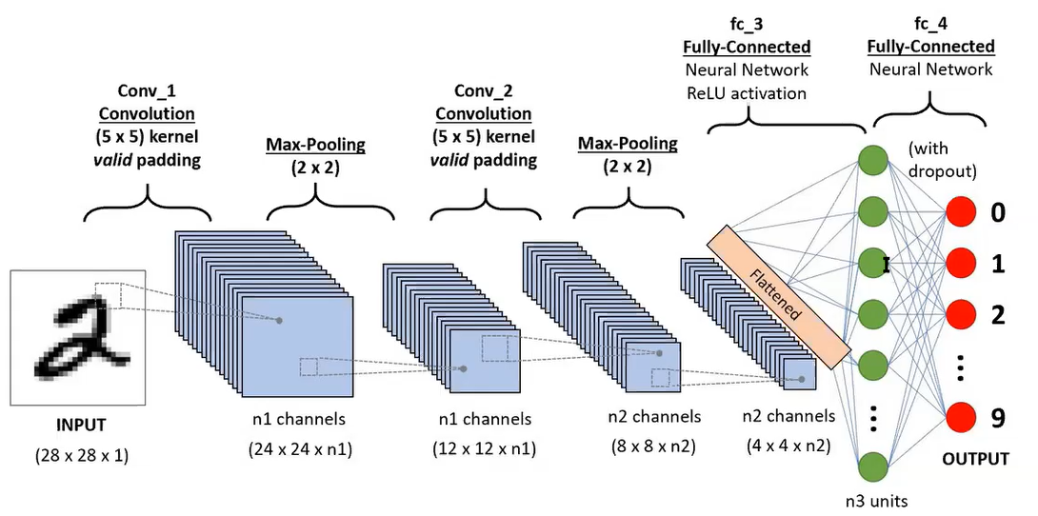

Slide 51
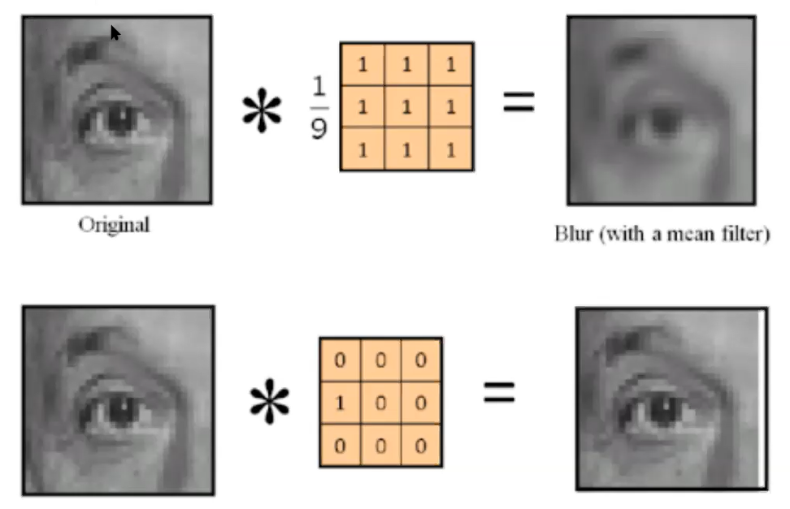

Slide 52


Slide 53

Dropout

Slide 54



Slide 55


Slide 56


Slide 57


Slide 58


Slide 59


Slide 60


Slide 61

Popular CNN architectures

Slide 62

Le Net (1998)

Slide 63

Alex Net (2012)

Slide 64

VGGNET (2014)

Slide 65

VGG16

Slide 66

Vgg 19

Slide 67

Google Net (2014)
Fig.4.16. Inception layer: naive version

Slide 68


